Slide 1
No Mercy Trivia
Chris Miller, Liana Moore, Joe Black
Notes:
Liana

Slide 2
Agenda
Introduction - What is No Mercy Trivia
Meet Team No-Mercy
Why No Mercy Trivia
Demo
Conclusion
Notes:
Liana

Slide 3
Introduction
No Mercy Trivia integrates with multiple APIs to bring the most up-to-date trivia questions on a wider variety of topics. Using its multiple APIs allows it to access more categories than another site would access with an individual API.
Recently, the trends have shown that trivia is on the rise, making No Mercy Trivia a critical product in today’s market.
Notes:
Liana

Slide 4
Meet the team
Chris Miller
Contribution: Game Play Page
Liana Moore
Contribution: Home Page
Joe Black
Contribution: Game Over Page
Notes:
Joe

Slide 5
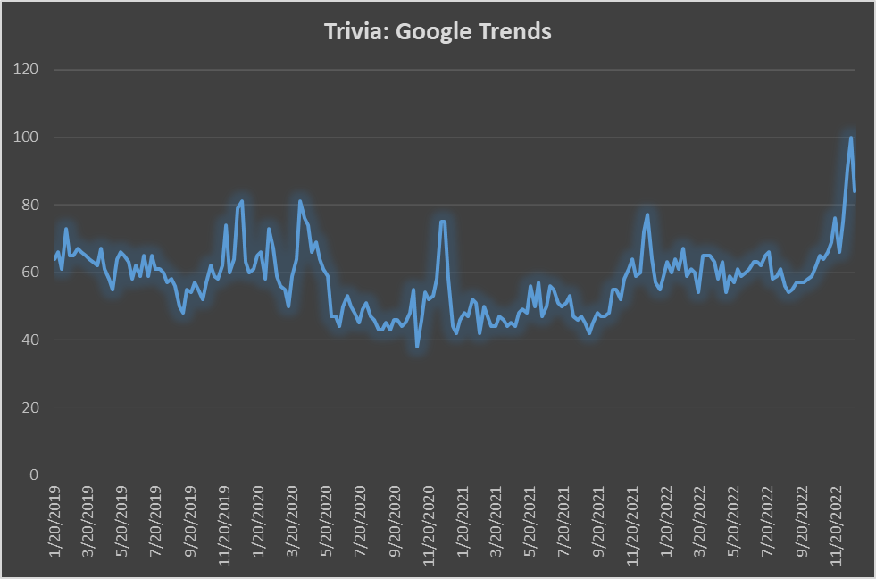
Why?
Google Trends
Highest search frequency in over 4 years
Valuable time to have high reachability
Notes:
https://trends.google.com/trends/explore?date=2019-01-14%202022-12-31&geo=US&q=trivia
Joe

Slide 6
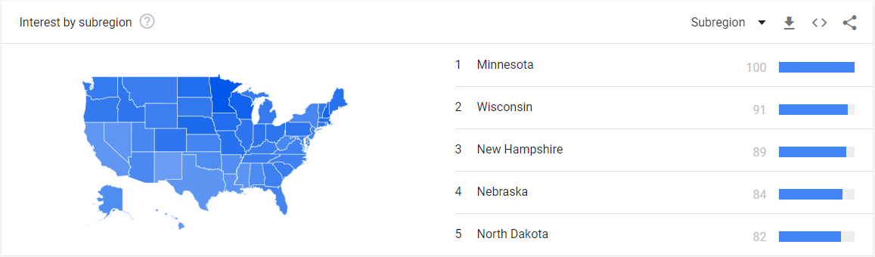
Why?
Wisconsin is the second most interested state in the same time period.
Notes:
Joe

Slide 7
Demo
Github Repository: https://github.com/J03B/no-mercy-trivia
Deployed Site: https://j03b.github.io/no-mercy-trivia/
Notes:
Chris

Slide 8
Future Development
Incorporate more categorical APIs
Randomize the correct answer button
Add a field for the number of questions
Add a difficulty option (integrates with some APIs)
Play Again with same settings option
Hard stops for invalid entries
Loading design while questions load
Notes:
Chris

Slide 9
Conclusion
No Mercy Trivia is the greatest choice on the web for a Trivia game that will strengthen your knowledge on a ton of subjects!
Our interesting selection of categories will help you decide what subject you would like to be questioned on. Once the game is over, you will have the option to play the game again on the same category to re-test your skills..
If you would like to switch up the category, you are able to do that as well.
Notes:
Chris

Slide 10
Questions?

